Slide 1
Map Reduce and Hadoop
S. Sudarshan, IIT Bombay
(with material pinched from various sources: Amit Singh, Dhrubo Borthakur)

Slide 2
The MapReduce Paradigm
Platform for reliable, scalable parallel computing
Abstracts issues of distributed and parallel environment from programmer.
Runs over distributed file systems
  Google File System
  Hadoop File System (HDFS)

Slide 3
Distributed File Systems
Highly scalable distributed file system for large data-intensive applications.
  E.g. 10K nodes, 100 million files, 10 PB
Provides redundant storage of massive amounts of data on cheap and unreliable computers
  Files are replicated to handle hardware failure
  Detect failures and recovers from them
Provides a platform over which other systems like MapReduce, BigTable operate.

Slide 4
Distributed File System
Single Namespace for entire cluster
Data Coherency
– Write-once-read-many access model
– Client can only append to existing files
Files are broken up into blocks
– Typically 128 MB block size
– Each block replicated on multiple DataNodes
Intelligent Client
– Client can find location of blocks
– Client accesses data directly from DataNode

Slide 5
HDFS Architecture
NameNode
1. filename
2. BlckId, DataNodes
o
Secondary
NameNode
Client
3.Read data
DataNodes
NameNode : Maps a file to a file-id and list of MapNodes
DataNode : Maps a block-id to a physical location on disk

Slide 6
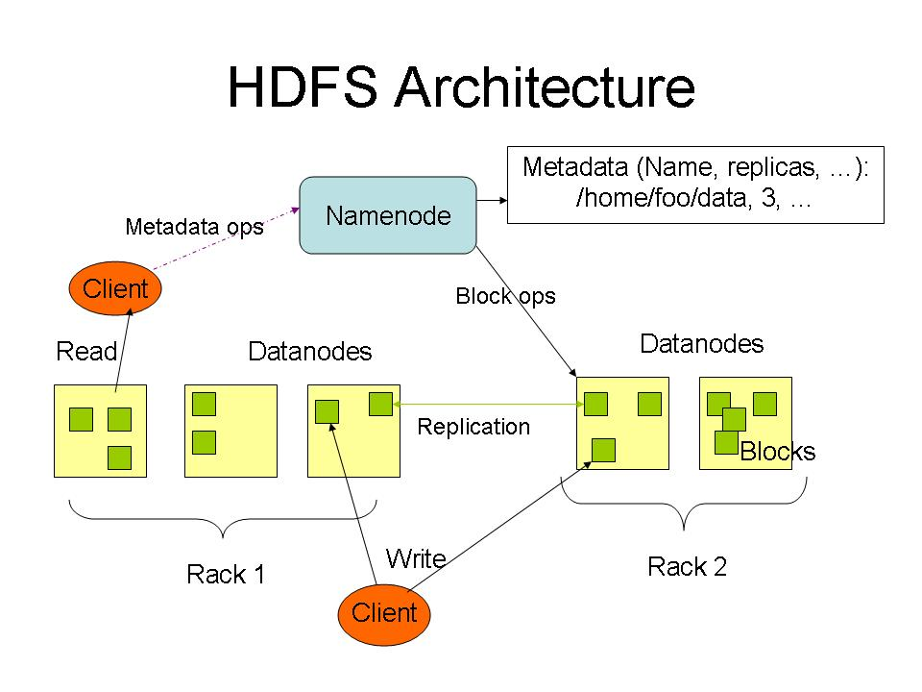

Slide 7
MapReduce: Insight
Consider the problem of counting the number of occurrences of each word in a large collection of documents
How would you do it in parallel ?
Solution:
  Divide documents among workers
  Each worker parses document to find all words, outputs (word, count) pairs
  Partition (word, count) pairs across workers based on word
  For each word at a worker, locally add up counts

Slide 8
MapReduce Programming Model
Inspired from map and reduce operations commonly used in functional programming languages like Lisp.
Input: a set of key/value pairs
User supplies two functions:
  map(k,v) → list(k1,v1)
  reduce(k1, list(v1)) → v2
(k1,v1) is an intermediate key/value pair
Output is the set of (k1,v2) pairs

Slide 9
MapReduce: The Map Step
Input
key-value pairs
Intermediate
key-value pairs
k
v
map
k1
v1
k
v
map
k2
v2
k
v
…
…
kn
vn
k
v
E.g. (doc—id, doc-content)
E.g. (word, wordcount-in-a-doc)
Adapted from Jeff Ullman’s course slides

Slide 10
MapReduce: The Reduce Step
Output
key-value pairs
Intermediate
key-value pairs
Key-value groups
reduce
k
v
k
v
v
v
k
v
reduce
k
v
k
v
v
k
v
group
k
v
…
…
…
k
v
k
v
k
v
E.g.
(word, wordcount-in-a-doc)
(word, list-of-wordcount)
(word, final-count)
~ SQL Group by
~ SQL aggregation
Adapted from Jeff Ullman’s course slides

Slide 11
Pseudo-code
map(String input_key, String input_value):
// input_key: document name
// input_value: document contents
  for each word w in input_value:
  EmitIntermediate(w, "1");
// Group by step done by system on key of intermediate Emit above, and // reduce called on list of values in each group.
reduce(String output_key, Iterator intermediate_values):
// output_key: a word
// output_values: a list of counts
  int result = 0;
  for each v in intermediate_values:
  result += ParseInt(v);
  Emit(AsString(result));

Slide 12
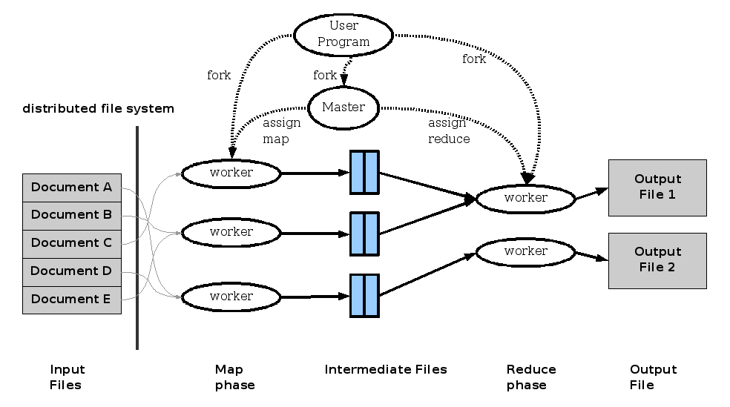
MapReduce: Execution overview

Slide 13
Distributed Execution Overview
User
Program
fork
fork
fork
Master
assign
map
assign
reduce
input data from
distributed file
system
Worker
write
Output
File 0
local
write
Worker
Split 0
read
Split 1
Worker
Split 2
Output
File 1
Worker
Worker
remote
read,
sort
From Jeff Ullman’s course slides

Slide 14
Map Reduce vs. Parallel Databases
Map Reduce widely used for parallel processing
  Google, Yahoo, and 100’s of other companies
  Example uses: compute PageRank, build keyword indices, do data analysis of web click logs, ….
Database people say: but parallel databases have been doing this for decades
Map Reduce people say:
  we operate at scales of 1000’s of machines
  We handle failures seamlessly
  We allow procedural code in map and reduce and allow data of any type

Slide 15
Implementations
Google
  Not available outside Google
Hadoop
  An open-source implementation in Java
  Uses HDFS for stable storage
  Download: http://lucene.apache.org/hadoop/
Aster Data
  Cluster-optimized SQL Database that also implements MapReduce
    IITB alumnus among founders
And several others, such as Cassandra at Facebook, etc.

Slide 16
Reading
Jeffrey Dean and Sanjay Ghemawat, MapReduce: Simplified Data Processing on Large Clusters
http://labs.google.com/papers/mapreduce.html
Sanjay Ghemawat, Howard Gobioff, and Shun-Tak Leung, The Google File System, http://labs.google.com/papers/gfs.html

